Slide 1
Mercury Toxicity
Steven Keener
Jereme sommers

Slide 2
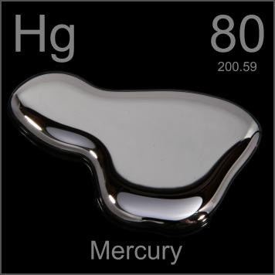
What is Mercury?
Mercury is a naturally occurring element that is found in air, water and soil. It exists in several forms: elemental or metallic mercury, inorganic mercury compounds, and organic mercury compounds

Slide 3
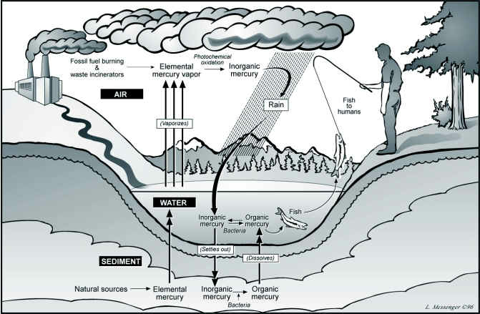
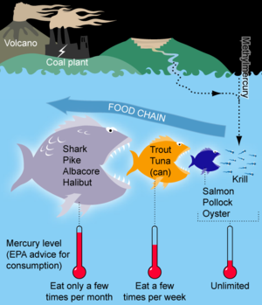
Where is Mercury Found?

Slide 4
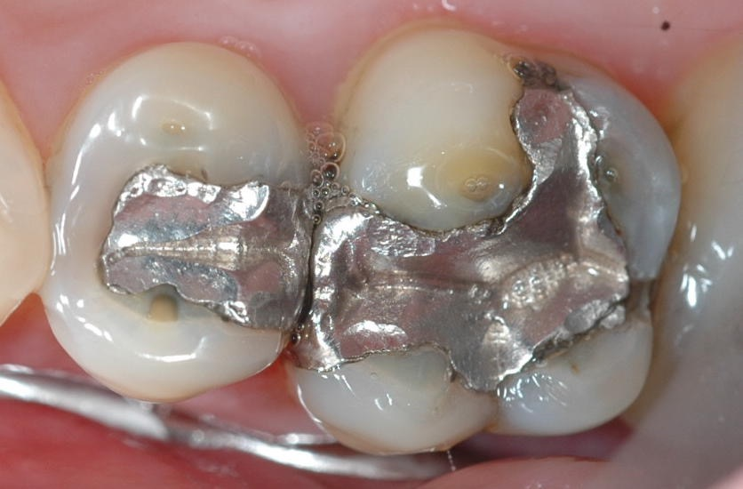
Where is Mercury Found?
Dental amalgam is a filling material made of between 43 and 54 percent mercury.
Amalgam is not stable after it is implanted into human teeth
Damage is caused by releasing small amounts of mercury vapor which is readily absorbed into the bloodstream and converted to inorganic mercury.
Inorganic mercury builds up far more in of elimination — it’s 100 times as high in your kidneys and liver than in your brain. But when it does make its way into your brain, it’s far more damaging than any other form.

Slide 5

Where is Mercury Found?
Many tattoo inks contain heavy metals that have been linked to a large number of health problems, including cancer and neurodegenerative diseases.
Among the most concerning metals found in tattoos are mercury, lead, antimony, beryllium, cadmium and arsenic.
Many red inks used for permanent tattoos contain mercury
Heavy metals, such as mercury give the tattoo its “permanence” in skin

Slide 6
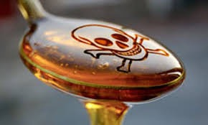
Where is Mercury Found?
According to a study published in the journal Environmental Health, almost half of the tested samples of commercial high-fructose corn syrup contained mercury
Also nearly a third of 55 popular brand-name food and beverage products where HFCS is the first- or second-highest labeled ingredient, according to another US study

Slide 7
Mechanism of Action
Mercury’s toxicity is related to inappropriate binding — it’s never a “free agent”
It is transported freely throughout the body including across:
blood–brain barrier
placenta, where it is absorbed by the developing fetus
Mercury’s favorite ligand is sulfur, especially a reduced form called a thiol.
Thiols are found throughout your body, for example in glutathione.
Enzymes use beneficial metals for their activity and hold those metals in place with thiol groups.

Slide 8
Mechanism of Action
Mercury has a far higher affinity for the thiols than do beneficial metals like zinc. How much greater?
In the case of zinc, a billion times! This means mercury fiercely grabs onto these groups and refuses to let go, depriving you of the good metals and stopping your normal biological processes in their tracks.
Mercury will also grab onto cell membranes, which leads to shattering of the membranes, vascular leakage, and subsequent “spackling” of the damage with cholesterol.

Slide 9
Mechanism of Action
Mercury toxicity results in neurologic symptoms including:
paresthesias
loss of physical coordination
difficulty in speech
narrowing of the visual field
hearing impairment
blindness
death
Children who had been exposed in-utero through their mothers' ingestion were also affected with a range of symptoms including motor difficulties, sensory problems and mental retardation
Video – Mercury destroying neurons

Slide 10
Metabolism and Elimination
Because this complex is readily absorbed into all tissues as well as its' strong binding to proteins, mercury is not readily eliminated.
Different forms of mercury have different half lives in the bloodstream ranging from 18 to 50 days.
The glutathione “supersystem” is your body’s main detoxification system. Glutathione binds to heavy metals, but it doesn’t do it alone — it requires the assistance of enzymes, antioxidants, and transport proteins.
Mercury elimination is by way of the feces

Slide 11
Risk Exposure
Calculator**
https://seaturtles.org/articles/advanced-calculator/
Advisory
http://www.oehha.ca.gov/fish.html
Bodies of Water**
http://www.oehha.ca.gov/fish/so_cal/index.html

Slide 12
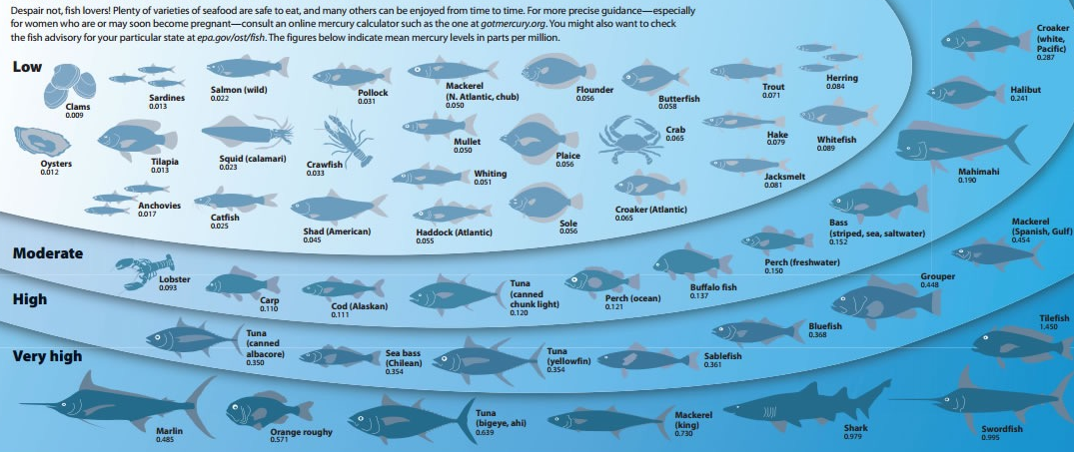
Keep in mind…
In the case of methyl mercury, fish size is important because large fish that prey upon smaller fish can accumulate more of the chemical in their bodies.
Mercury may be present in the liver and other organs of the fish. These organs should not be eaten.
It is better to eat the smaller fish within the same species, provided that they are legal size.

Slide 13
References
http://oehha.ca.gov/fish/hg/index.html
http://oehha.ca.gov/fish/fishbuyersguide.html
http://www.ncbi.nlm.nih.gov/pubmed/4091651
http://en.wikipedia.org/wiki/Mercury_poisoninghttp://oehha.ca.gov/fish/hg/index.html
Miriam Varkey, Indu, Rajmohan Shetty, and Amitha Hegde. “Mercury Exposure Levels in Children with Dental Amalgam Fillings.” International Journal of Clinical Pediatric Dentistry 7.3 (2014): 180–185. PMC. Web. 5 Mar. 2015.
Daisuke Tsuruta, Junko Sowa, Natsuko Higashi, Hiromi Kobayashi, Masamitsu Ishii, A red tattoo and a swordfish supper, The Lancet, Volume 364, Issue 9435, 21–27 August 2004, Page 730, ISSN 0140-6736, http://dx.doi.org/10.1016/S0140-6736(04)16903-
http://www.sciencedirect.com/science/article/pii/S0140673604169031
TOXICOLOGICAL PROFILE FOR MERCURY. (1999). Agency for Toxic Substances and Disease Registry. Dufault, R., LeBlanc, B., Schnoll, R., Cornett, C., Schweitzer, L., Wallinga, D., … Lukiw, W. J. (2009). Mercury from chlor-alkali plants: measured concentrations in food product sugar. Environmental Health, 8, 2. doi:10.1186/1476-069X-8-2http://www.naturalnews.com/043593_tattoos_heavy_metals_poisoning.html##ixzz3TLt5ne3n

